Slide 1
WELCOME
End of Transition 2019

Slide 2
Exam Results - highlights
S5 1@6 up 1% and third year increase
S5 5@6 - same as last year and second best ever
S6 1@6 - up 5% and second year of improvements
S6 3@6 - continue as best ever
S6 5@6 - continue as best ever
S6 1@7 - up 1% and now best ever

Slide 3
Creativity and fun at our school

Slide 5
The S1 experience at Tynecastle High School
Challenge and high expectations
Be ready, Be respectful, Be your best
Restorative practices
S1 remain in school at break and lunch
Uniform, attendance and punctuality
Setting in S1 Maths and English classes
Notes:
In classes maximising potential support and challenge through setting – maths & English, maximising use of technology equipment ; homework (Edmodo),

Slide 6
How will I be kept informed of my son / daughter’s progress?
S1 Course Information booklet on our website
5 Target Setting reports throughout the year: September, November, January, March, May
Thursday 24 October, 4.30-7pm: S1 consultation for parents / carers
Merits / demerits summary: twice a term

Slide 7
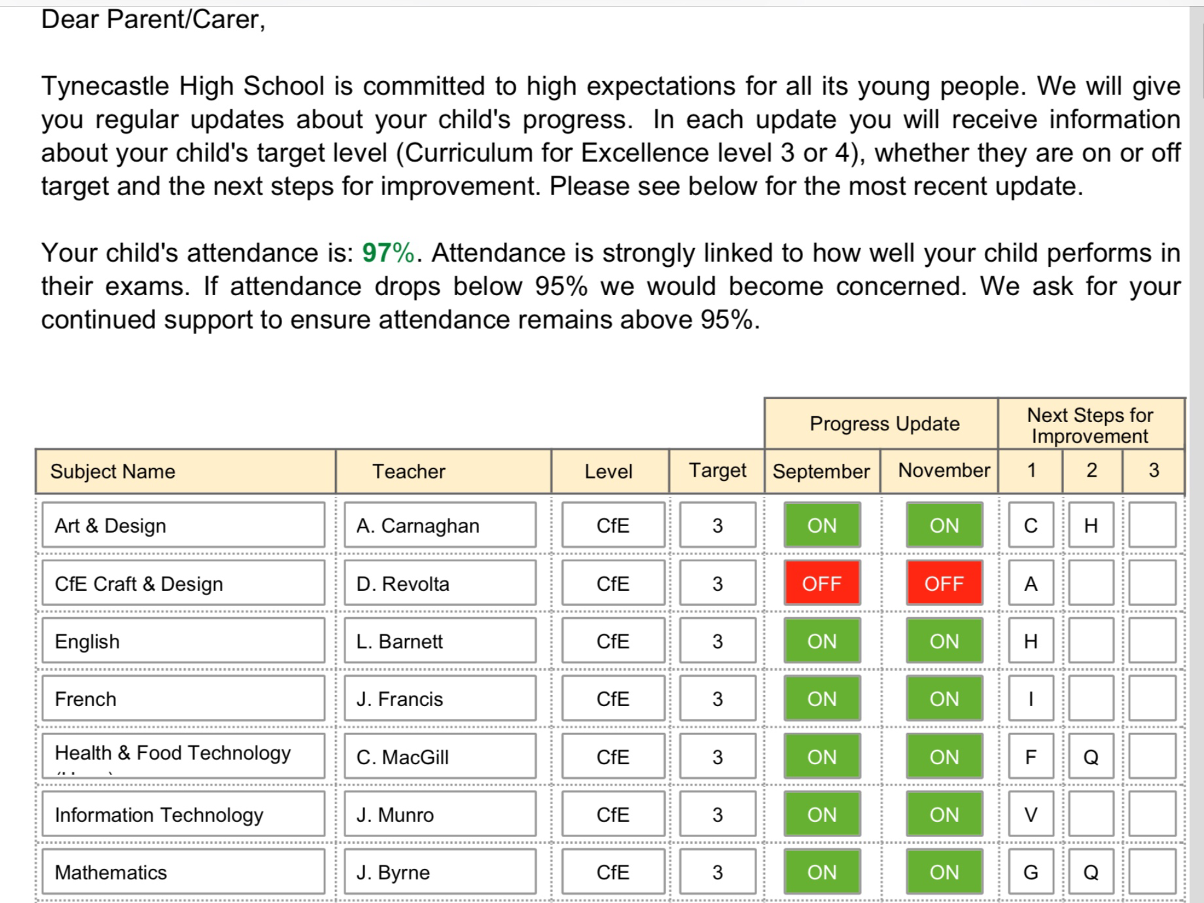

Slide 8
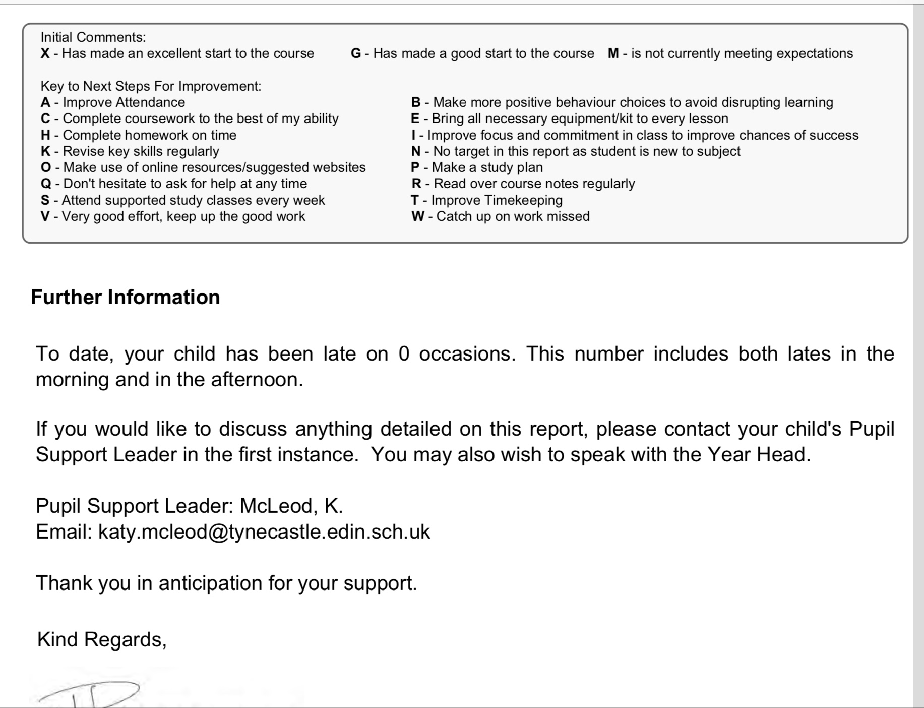

Slide 9
Music tuition
All S1s are offered a trial with chosen instrument
S1 continuers now all have a timetable
S1 beginners start in September
Piping and drumming: lessons are Monday during school. Practice is Tuesday 4-5.30
Notes:
Transfer of information – lit, num

Slide 10
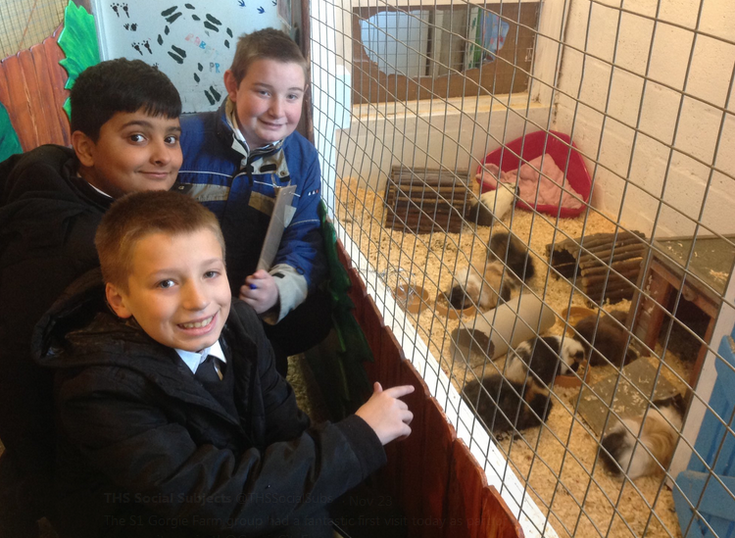
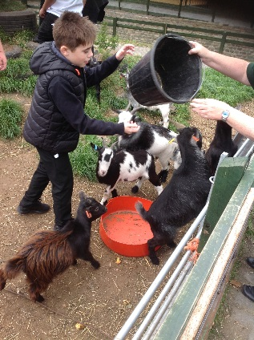
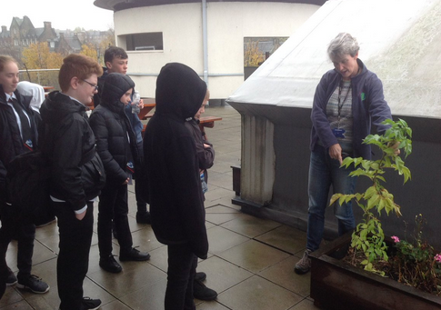
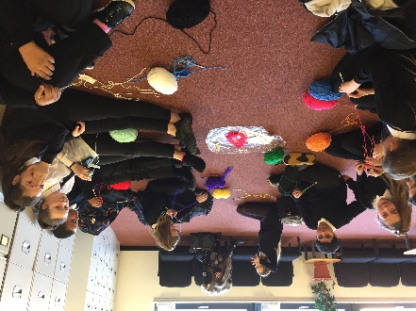
Me and My World
Adventure
“I think I’m more confident on a bike and I can cycle more. This activity was great.”
All S1s have a timetabled period of JASS a week. Throughout the year they work towards their Gold Award by completing the 4 sections. They build on lots of skills, work with community groups and explore new things. The award is very different for each individual.
My Interest
“Football-I found it hard at the beginning. I learned that it is good to practise using your other foot so you can get better.”
Get Active

Slide 11
is a peer mentoring programme that gives young people the chance to explore and challenge the attitudes, beliefs and cultural norms that underpin gender-based violence, bullying and other forms of violence.
It allows young people the opportunity to develop their confidence, communication skills, leadership and organisational skills.

Slide 13
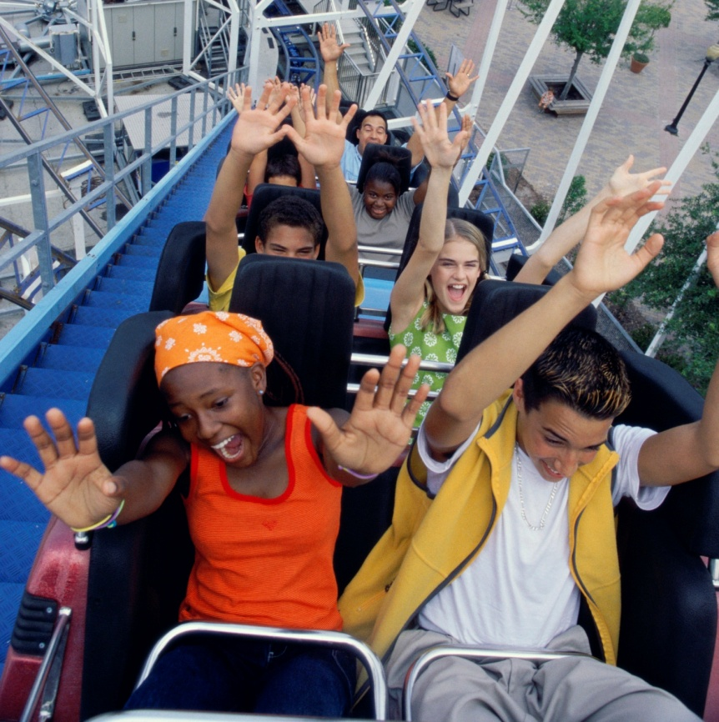
Raising Teens with Confidence
1. Introductory Session:
Why what you do matters
2. The Amazing Teenage Brain:
What’s going on in there?
3. Risky Business:
Managing adventure, risk and resilience
4. It’s Good To Talk:
The importance of staying connected
5. Flipping Your Lid
Looking at the brain under stress
6. Looking After Your Wellbeing:
Coping with the changes
Teens

Slide 14
Involvement in the Life of the School
Clubs
Assembly performances
Sporting tournaments
Curricular visits and competitions
Leadership opportunities for students
Pantomime
Notes:
Leadershiship: Former S1s talking about their S1 experience;

Slide 15
Communication
Pupil Support Leader - a key person
Email and text communication
Website: www.tynecastle.edin.sch.uk
Maildrops – throughout the year by post / through your child
In-school supports for parents / carers
Focus groups
Parent Council welcomes new members!

