Slide 1
And Week

Slide 2
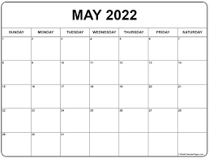
When!
Tuesday, May the 24th Periods 5, 6 and 7 (and over lunch!)

Slide 3
Here are some
you can sign up to...

Slide 4
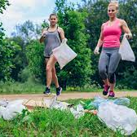
Plogging
Who: Mr Pickering and Miss Sheddon
What: Litter picking and light jogging!
Want to stay fit and look after your environment and local community? Get involved with this wholesome task, do some good for you and others!
Where: The local area.
Cost: Free!

Slide 5
Science Experiments
Who: Dr Danioux and Miss Scott
What: Science Experiments.
Have you ever wanted to get involved in a NATIONAL science project? Now is your chance!
Where: Lab T010
Cost: £1

Slide 6
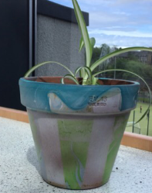
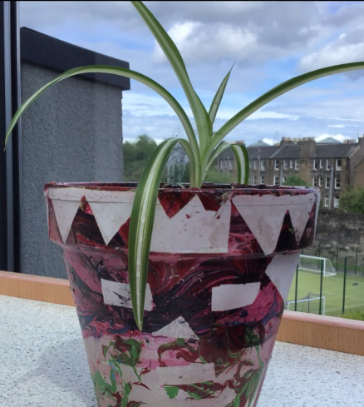
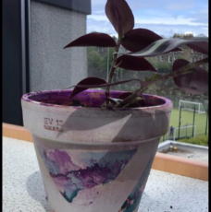
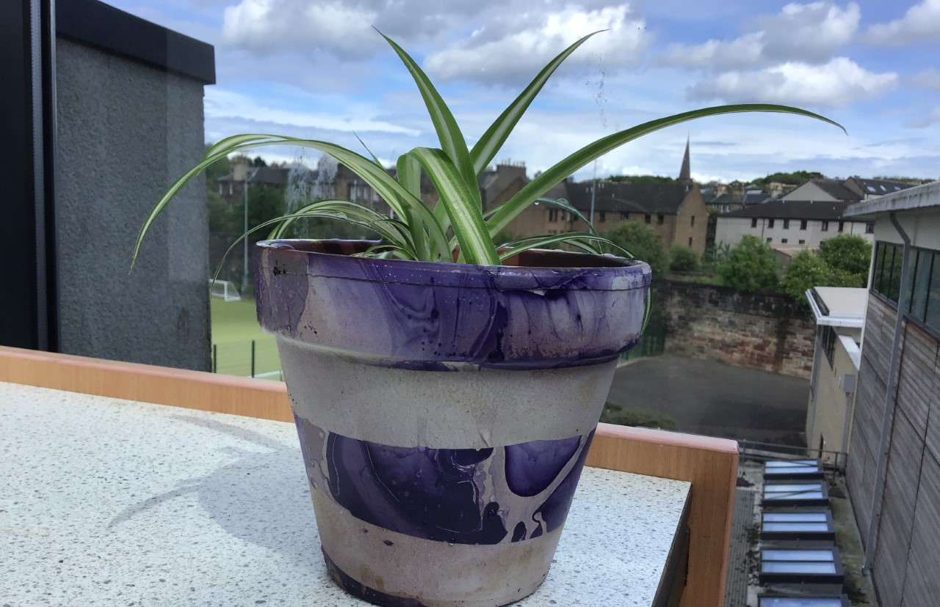
Craft
What: Hand decorate a terracotta pot and plant it with a house plant.
These make a lovely gift and are sure to brighten any windowsill. These designs were achieved by hydro dipping, come along and have a go.
Where: In school
Cost: £1

Slide 7
Who: Mr Mackenzie and Ms Bowerman!
Where: Fountainbridge Library
What: Create a mural with cut out, manga graphic novels and superhero character images! Free cakes!
Cost: Free!

Slide 8
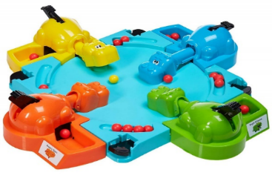
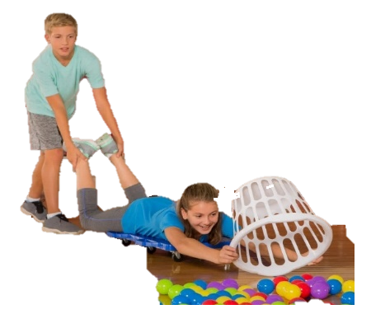
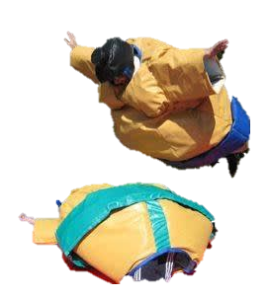
….version 3.0
&
Boxfit & Boxercise
coaching
&
Human Sized
‘Hungry Hippos’
Sumo
When: Tuesday 24th & Wednesday 25th & Thursday 26th June 2017
Where: Tynecastle High School – Playground – Weather permitting
How Much? £0.00 FREE
MAX 60 people per day
(priority or spaces given based
on class merits and demerits)

Slide 9
Girls Run Club
Who: Mrs Clarke and Mrs West
What: A relaxing run.
Want to run at a pace you enjoy in the company of likeminded friends? Want to pick up running tips from the pro's? Don’t know where to start but want to? Come, relax and take it all in your (jogging) stride!
Where: The local area.
Cost: Free!

Slide 10
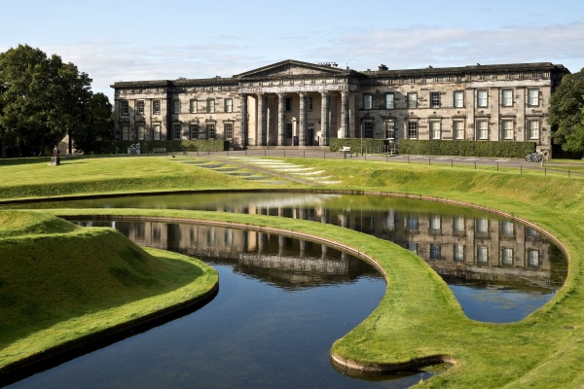
Gallery Walk
Who: Mrs Carnaghan and Miss Statham
What: A lovely walk down the Water of Leith followed by a wonder round the Gallery of Modern Art.
A scenic walk down followed by beautiful and intriguing artwork? What's not to love! A feast for all the senses!
Where: Water of Leith and the Gallery of Modern Art.
Cost: Free!

Slide 11
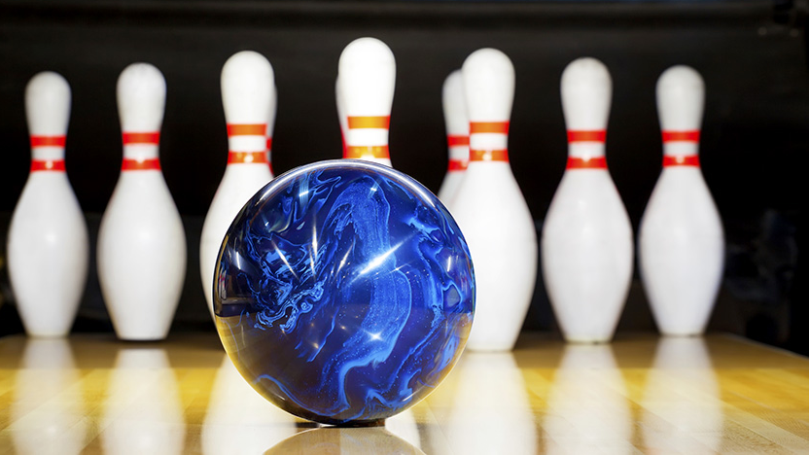
Bowling
Who: Miss Peaston
What: Ten Pin Bowling
Competitive Spirit? Amazing hand and eye co-ordination? Or just love the thrill of knocking over pins? Come along with friends and relax over a game of ten pin bowling!
Where: Fountainbridge Bowling Alley.
Cost: £2

Slide 12
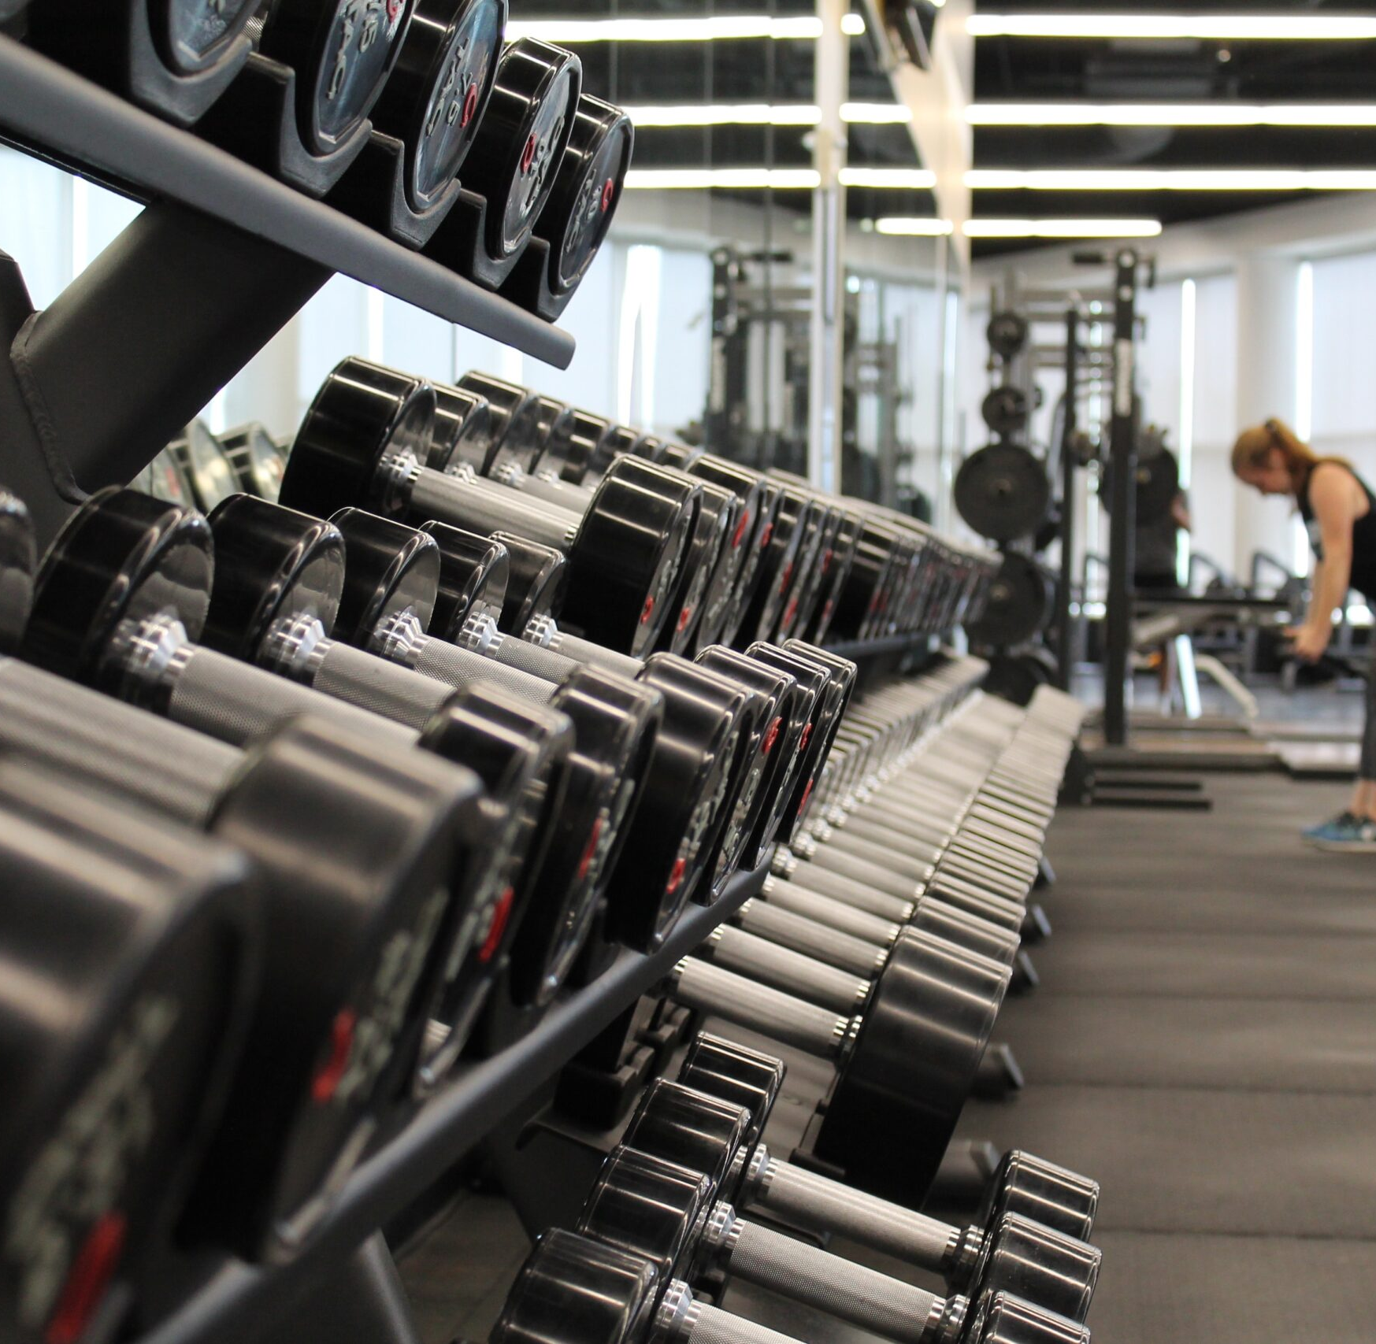
Gym
Who: Mrs Moultray
What: Gym Session
Do you feel at your most relaxed when working out? It's great for mind body and spirt! Come along to this gym session to see how you can use the gym to get the best out of your workout!
Where: Dalry Gym.
Cost: £1

Slide 13
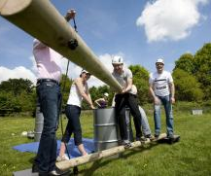
Leaderless Tasks
Who: Miss Potts and Kev
What: Leadership without the leader.
Could you cross shark invested custard, across a narrow beam with a blindfold on? Could you get your team to safety? Can you lead? Ever wondered what skills you need to have to be a successful leader? Come and find out!
Where: School!
Cost: Free!

Slide 14
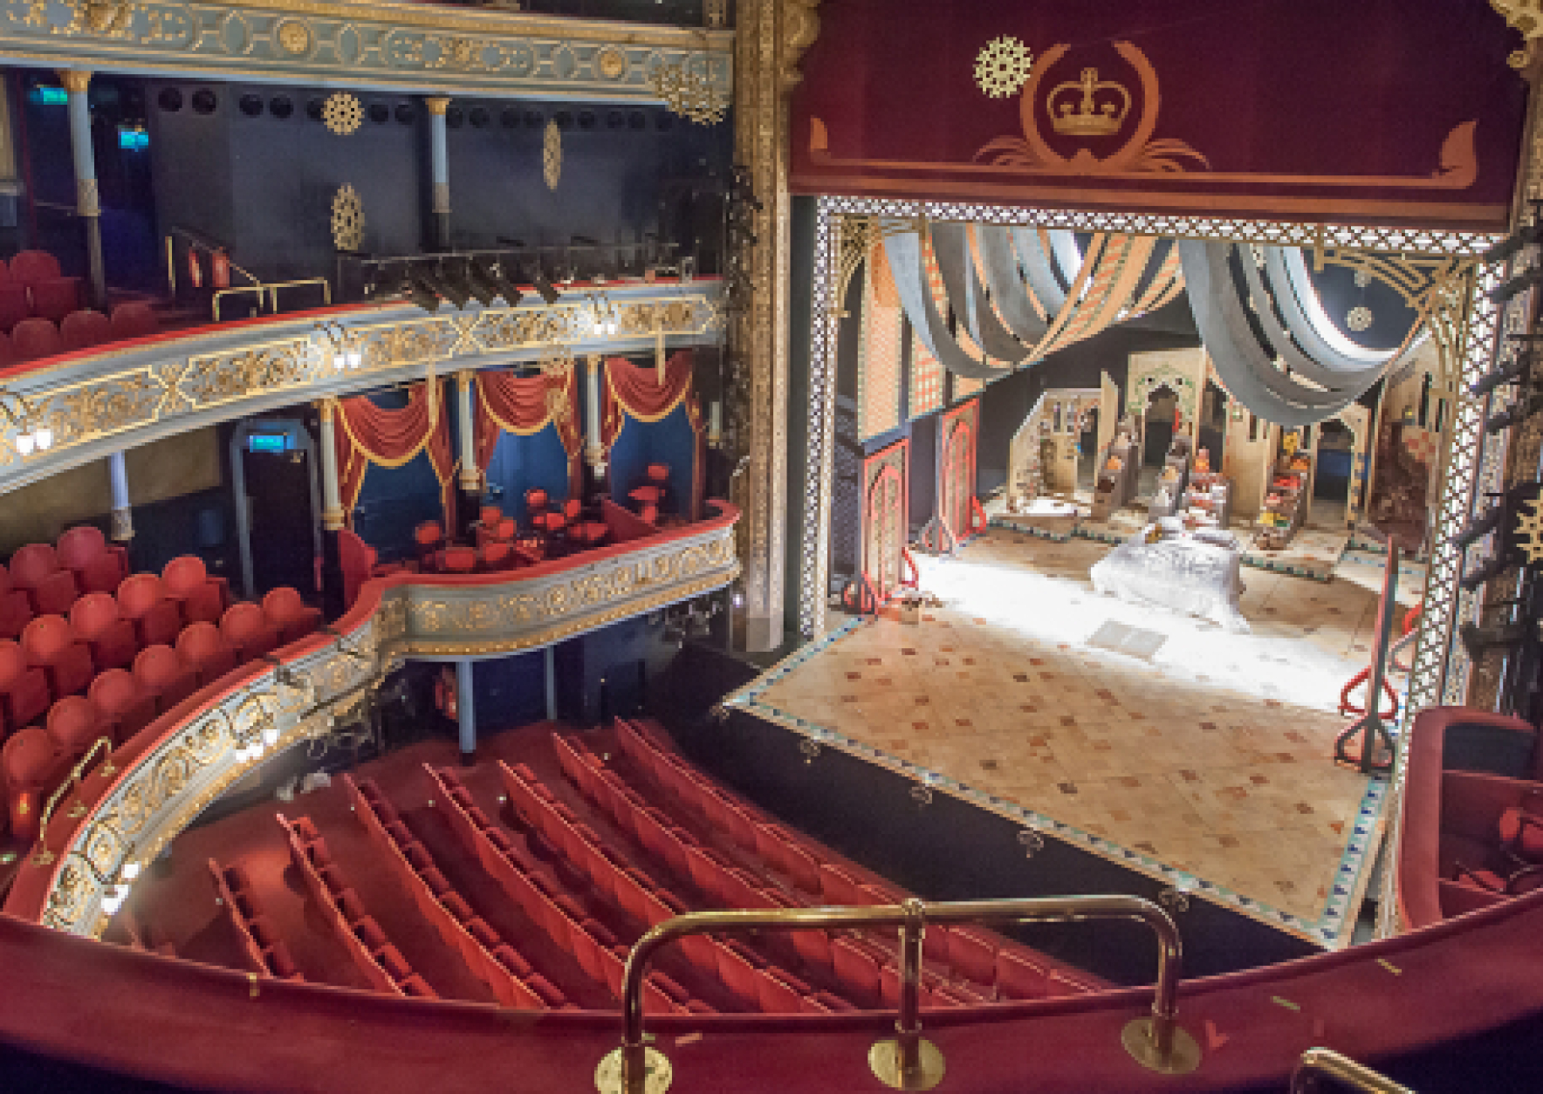
Lyceum Theater Workshop
Who: Mr Blain and Mrs Pugh
What: Theater Workshop
Ever wondered what it would be like to be center stage? The spotlight on you? Come find out and learn those all-important performance skills!
Where: Lyceum Theater
Cost:

Slide 15
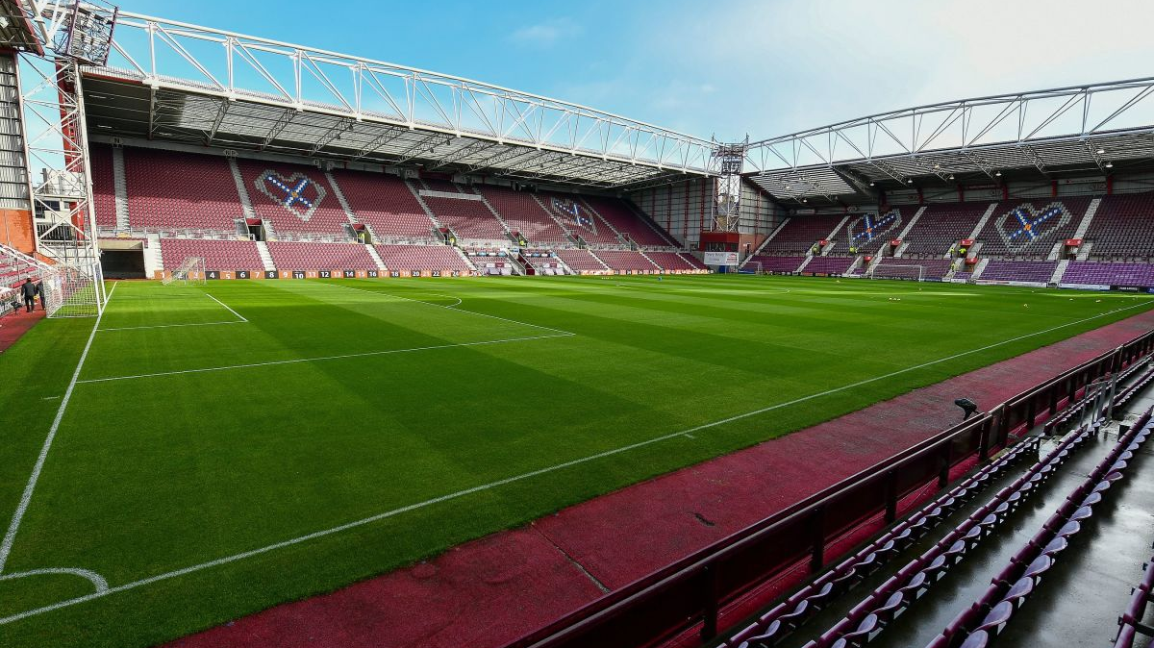
Hearts Stadium Tour
What: A tour around Hearts Football Stadium.
Are you their biggest fan? A huge supporter? Or just wonder what the football industry is like? Come and tour the stadium and find out what's on the other side of the road!
Where: Tynecastle Football Stadium
Cost: £1.50

Slide 16
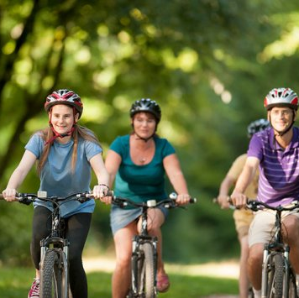
Cycling
Who: Miss Rose, Mr Cook, Ms Clarke,
Ms Brown, Ms Pirie, Ms Wilson, Ms Karoyan
What: Bike ride
Spend a couple hours whizzing round your hometown and seeing the sites by bike! No better way to do it!
Where: The local area.
Cost: Free!
*You must be comfortable riding a bike to join us.
Don't have a bike? We have a limited supply - it's first come first serve!

